Slide 1
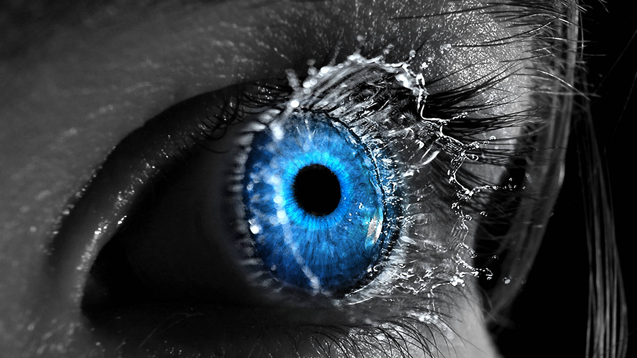
EyeSphere
360º
Members:
Sergi de las Muelas
Adrià Barceló Luna
Nil Cosano Alcudia
Alexandra Velásquez

Slide 2

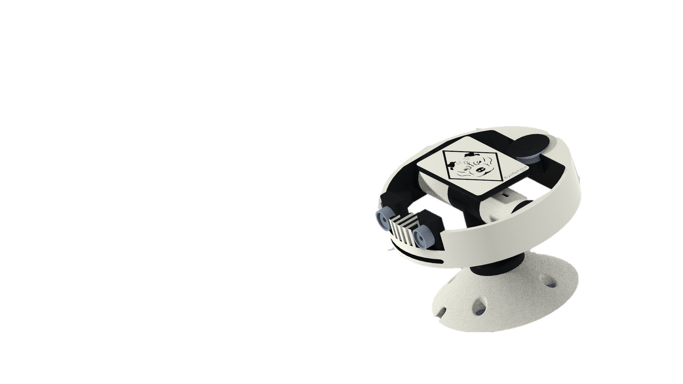
Robot start components:
1 Arduino Nano: Procesat motors
1 Raspberry pi 3 B: Procesat imatge
1 Serbomotor: Per rotació 180º
2 Camares: Per aconseguir otorgar l’efecte de profunditat.
1 Motor Brushless+encoder: Per rotació 360º

Slide 3
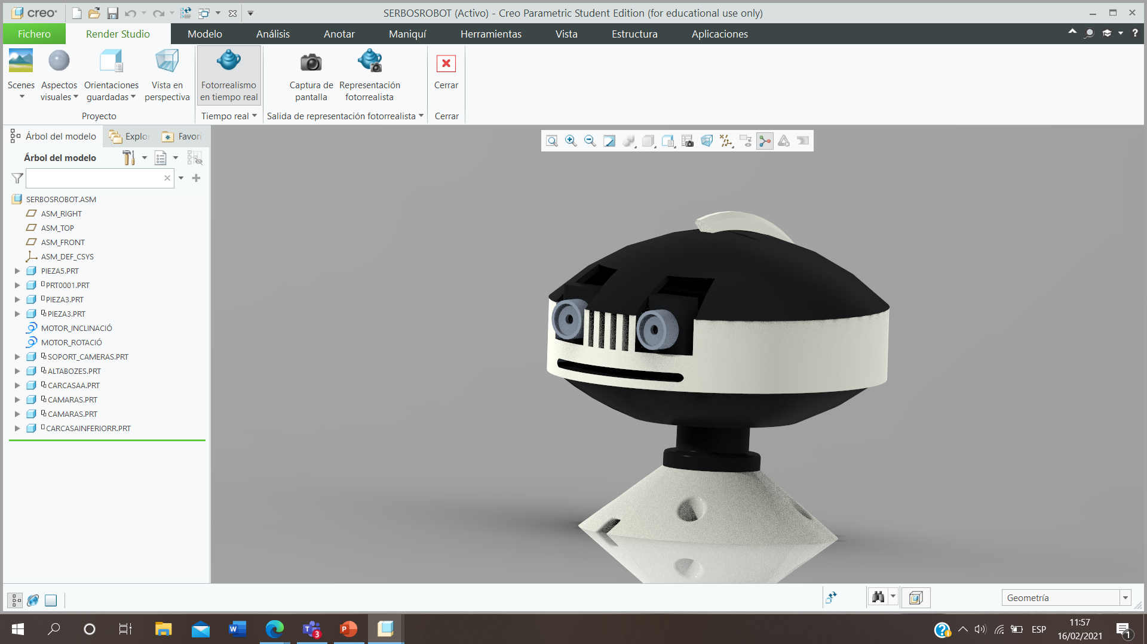
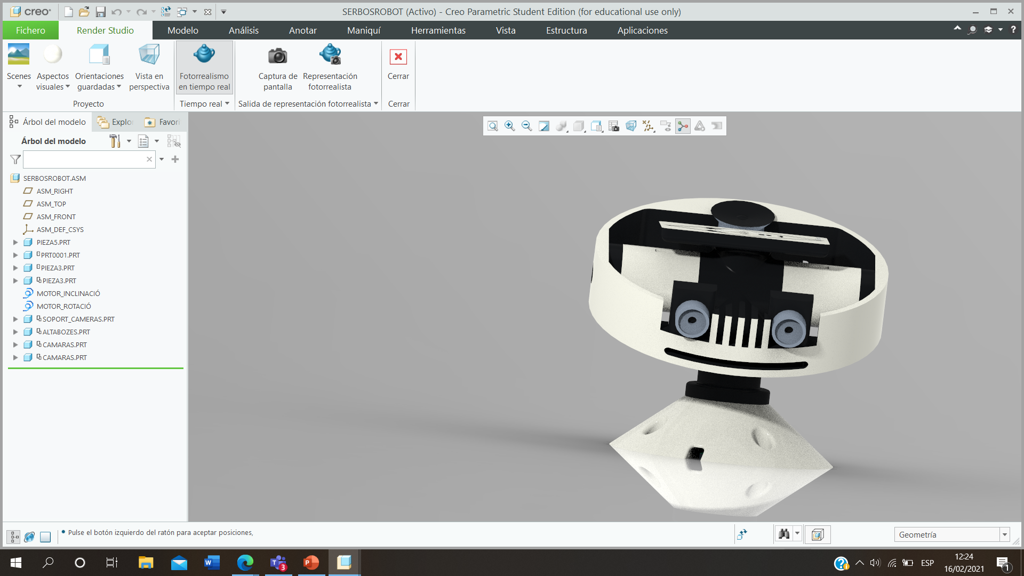
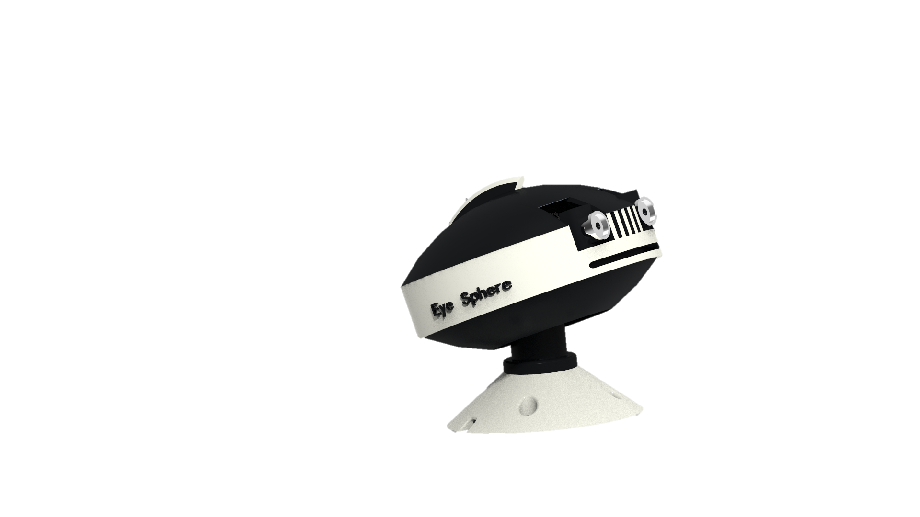
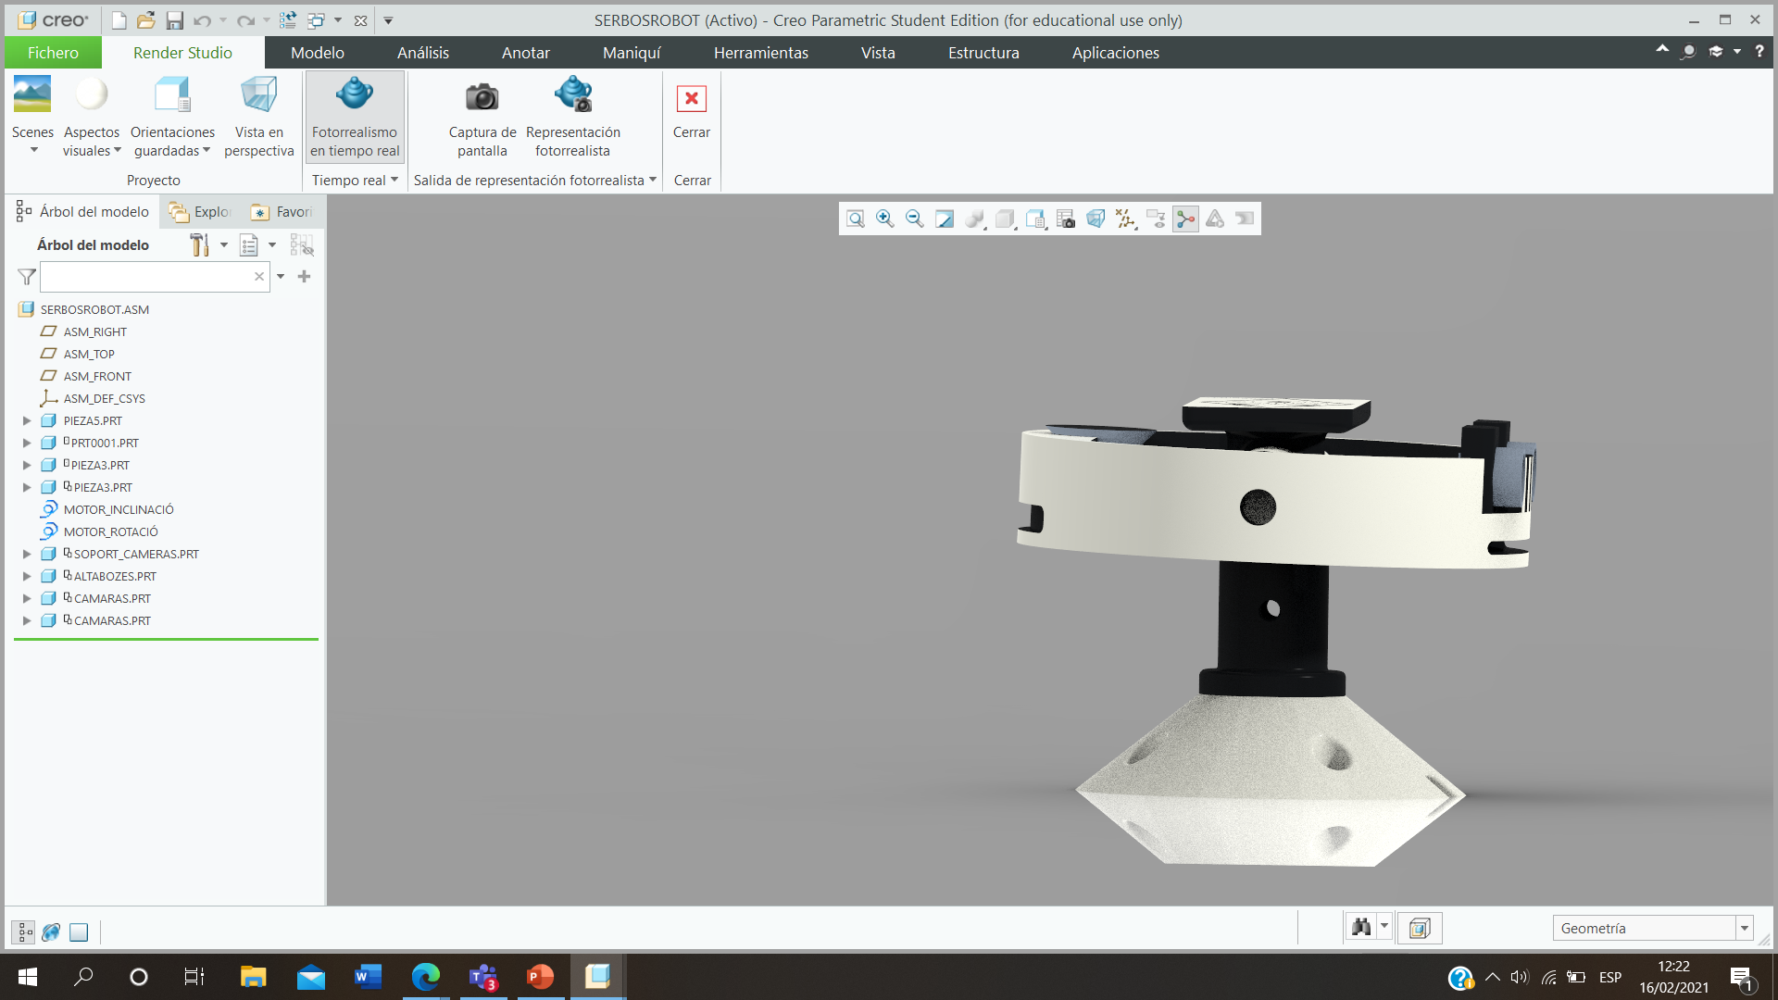
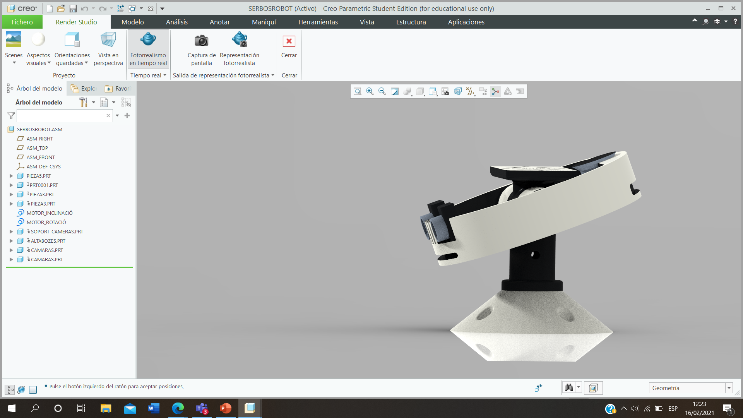
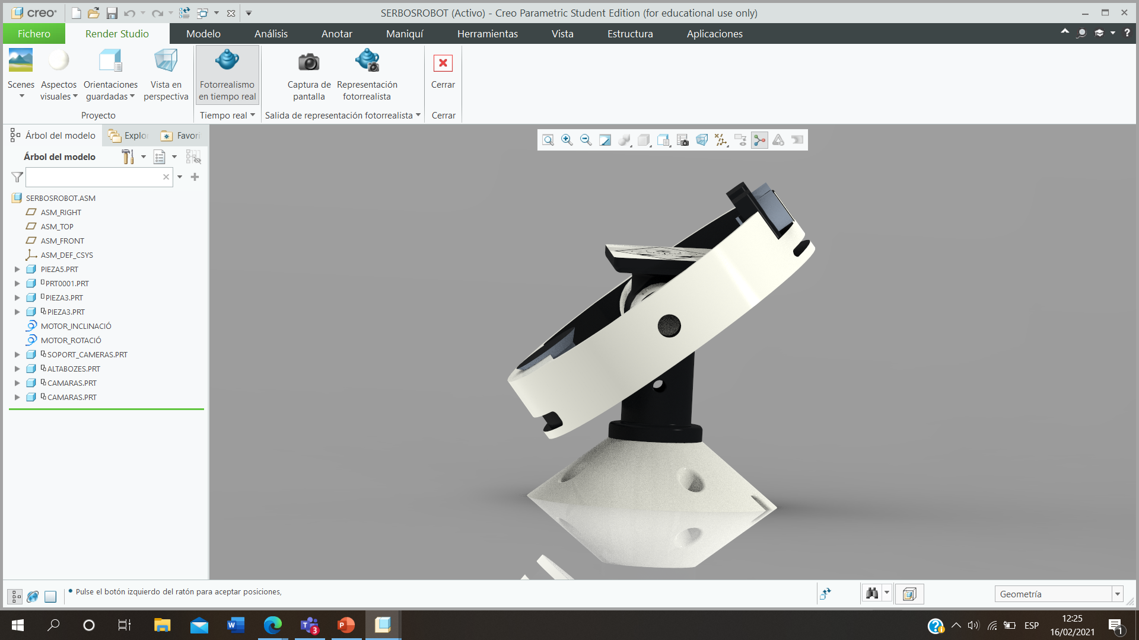
eyesphere360@gmail.com

Slide 4
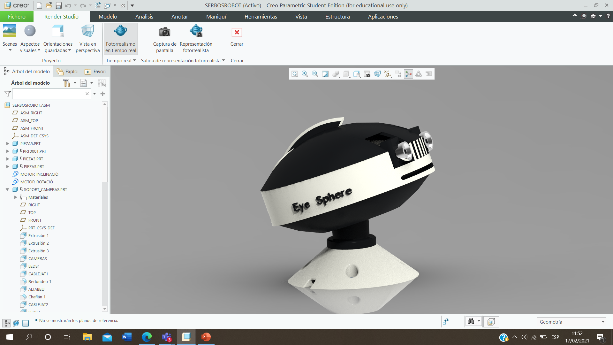

Slide 5
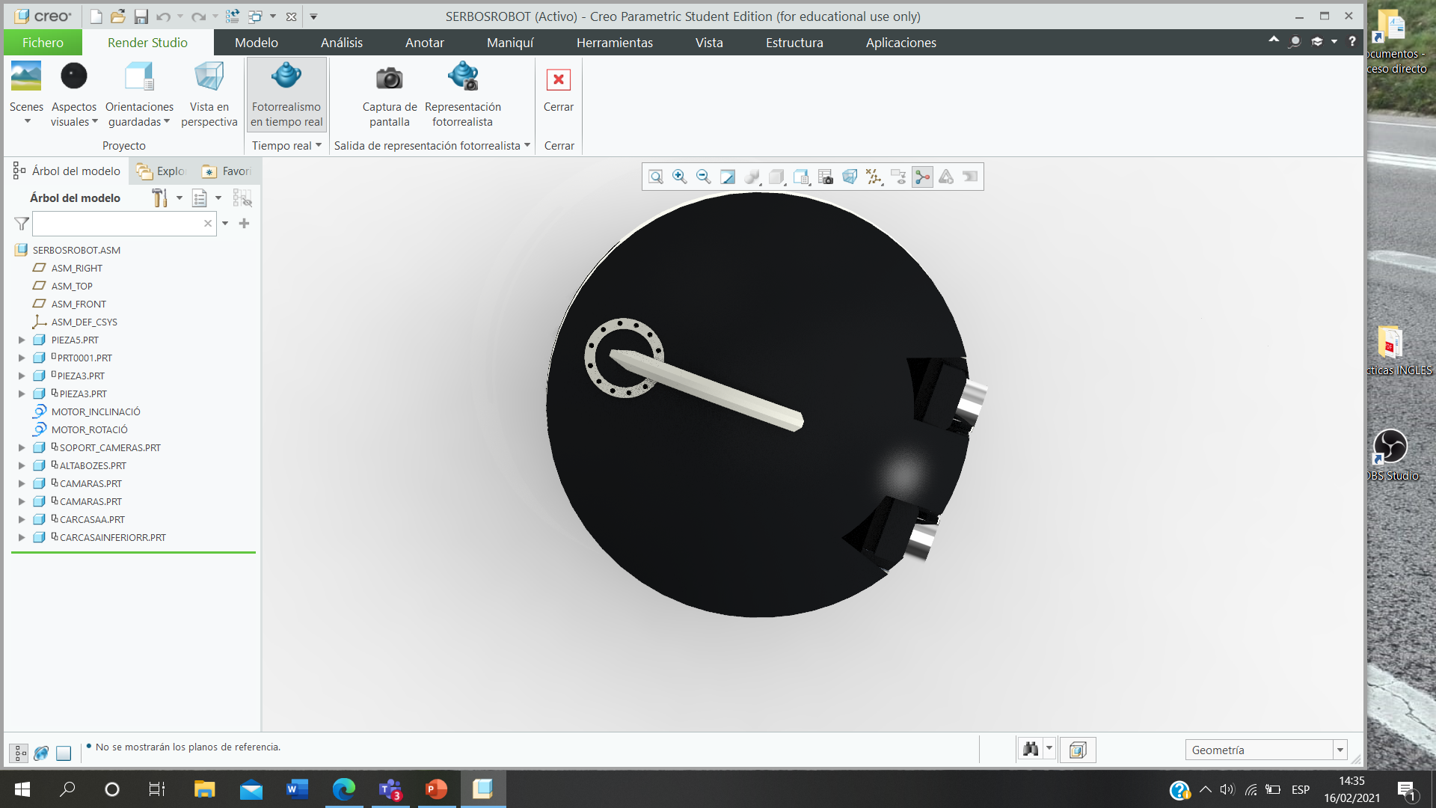
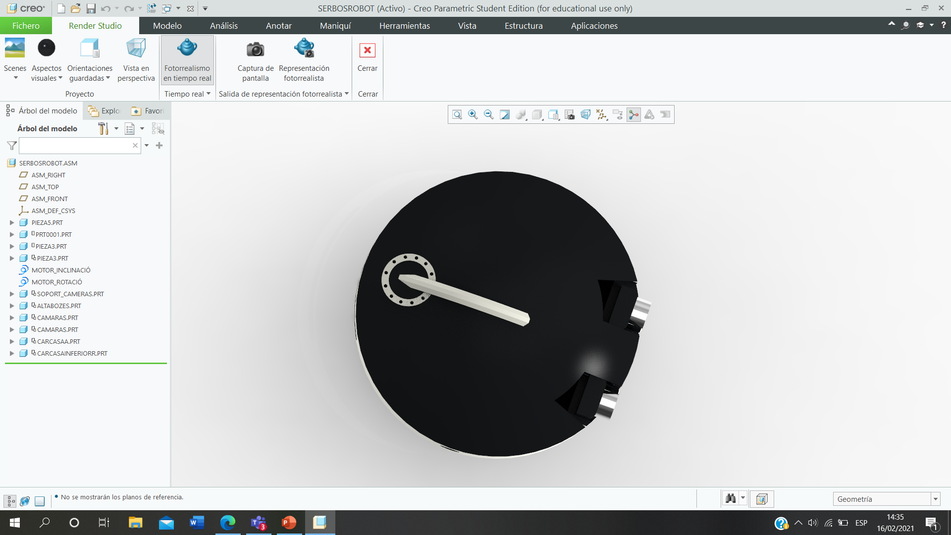

Slide 6
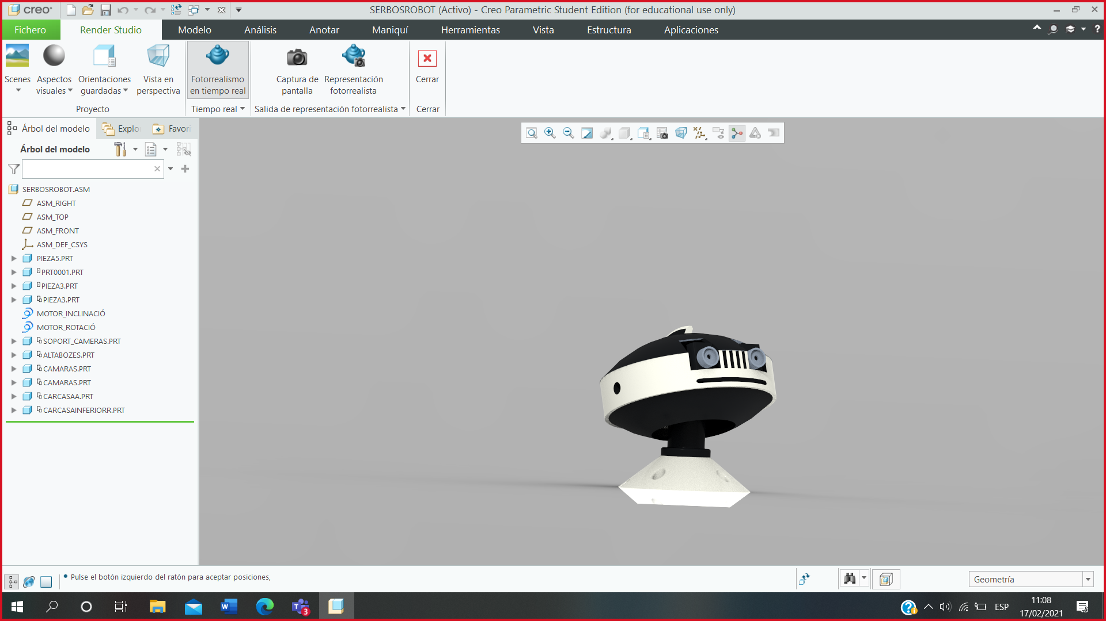
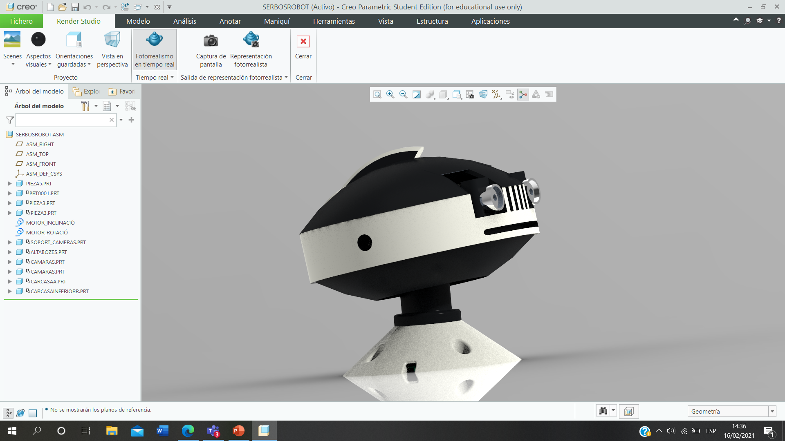

Slide 7
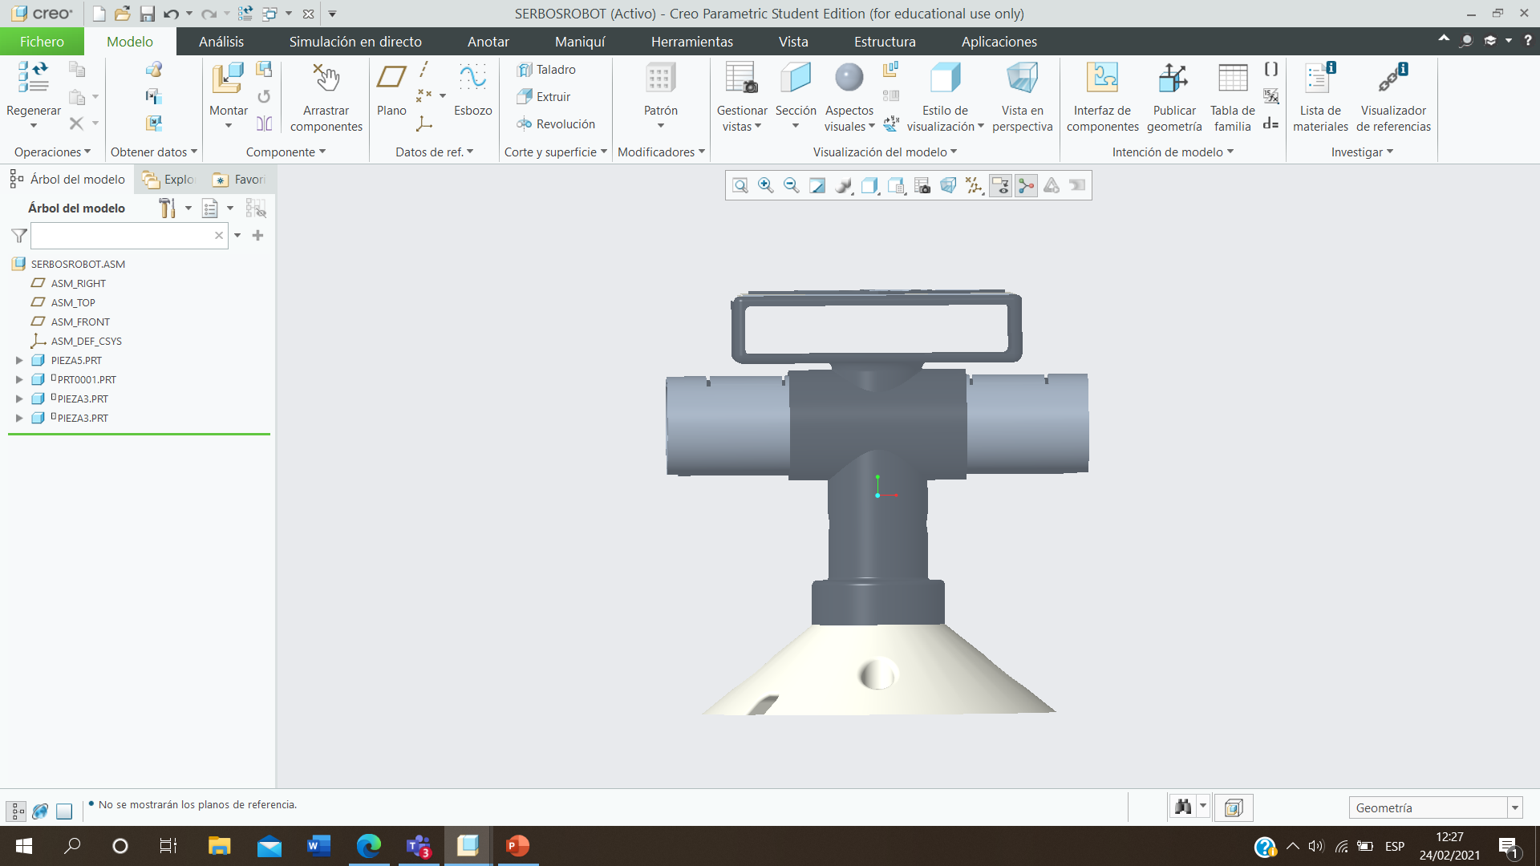
ARDUINO NANO
5 V
5 V
BLASBERRYPY
Placa
C= Colector giratori
I= Interuptor on/off
C
12 V
I

Slide 8
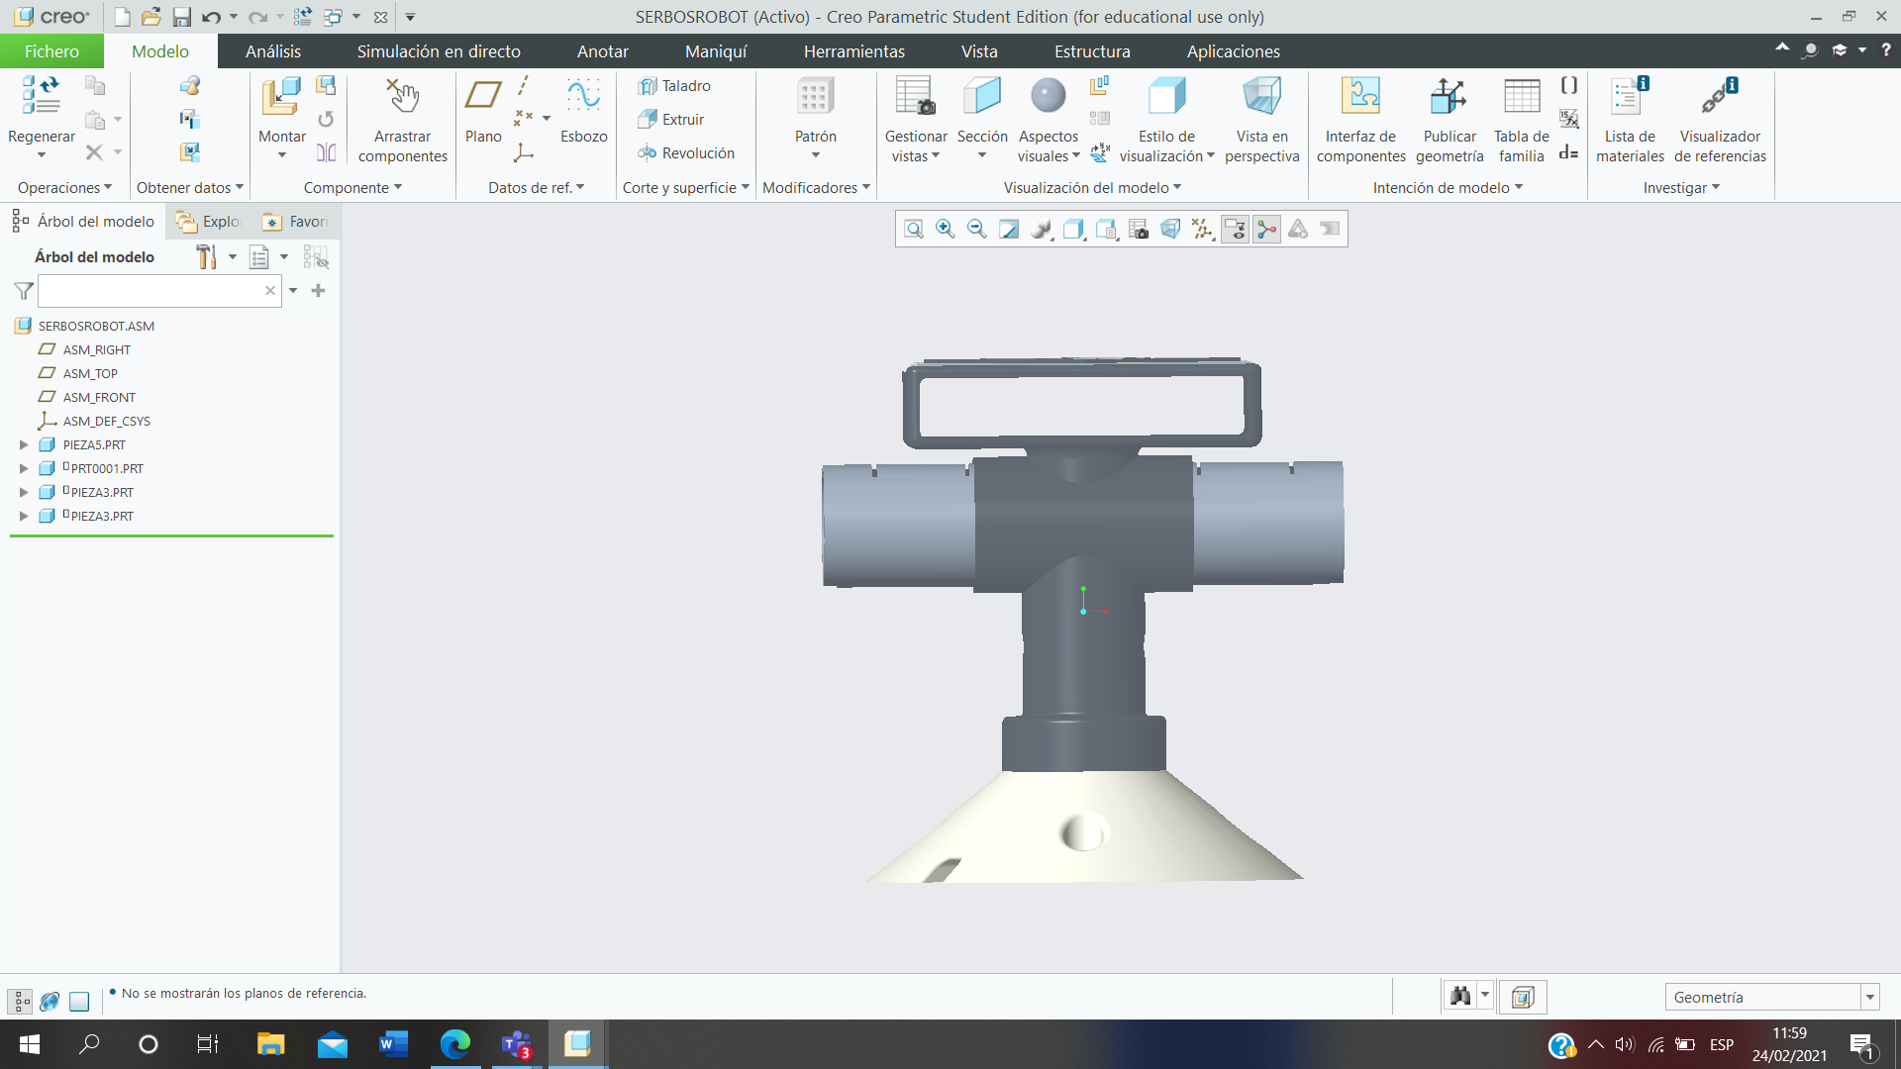
S= Servomotor
M= Motor brushless + encoder
ARDUINO
S
M

Slide 9
BLASBERRYPY
2Camaras
USB

Slide 10
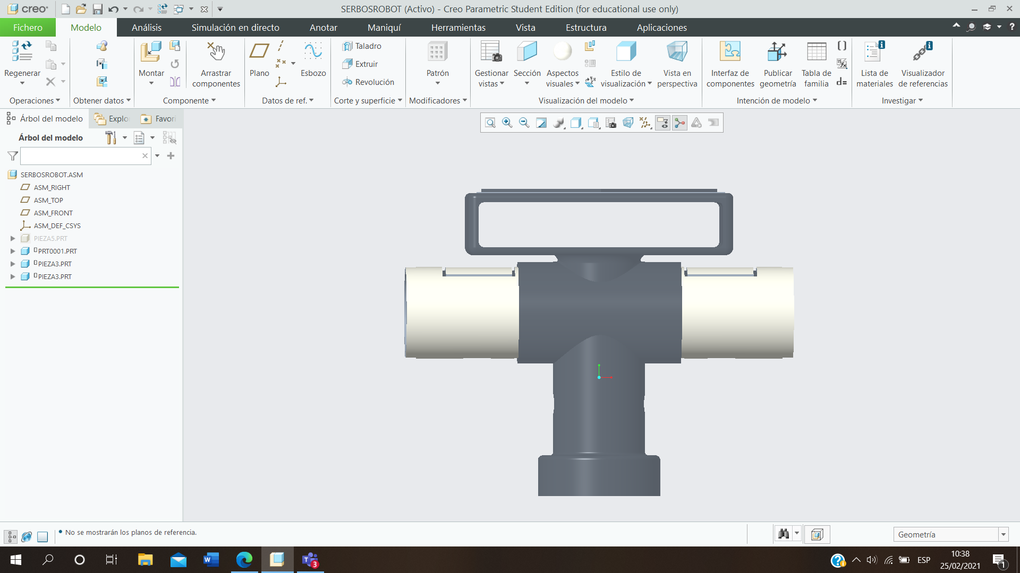
CALCULATIONS OF CENTER OF MASSAS:

Slide 11
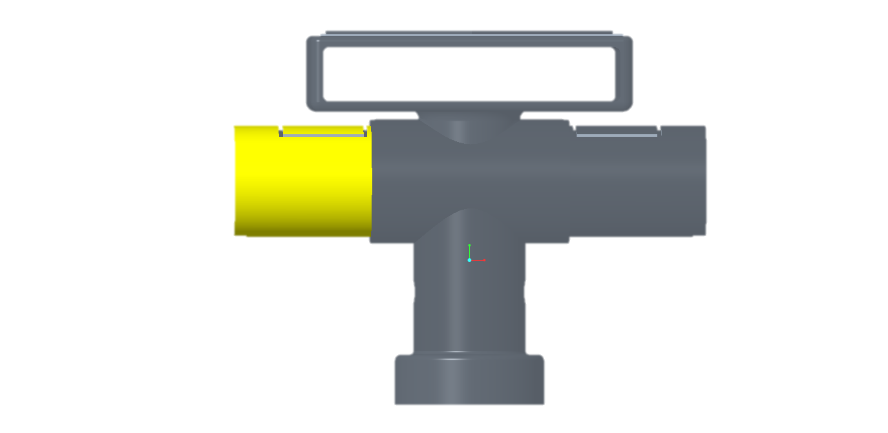
Y
80 - 22,5mm
X
Z

Slide 12
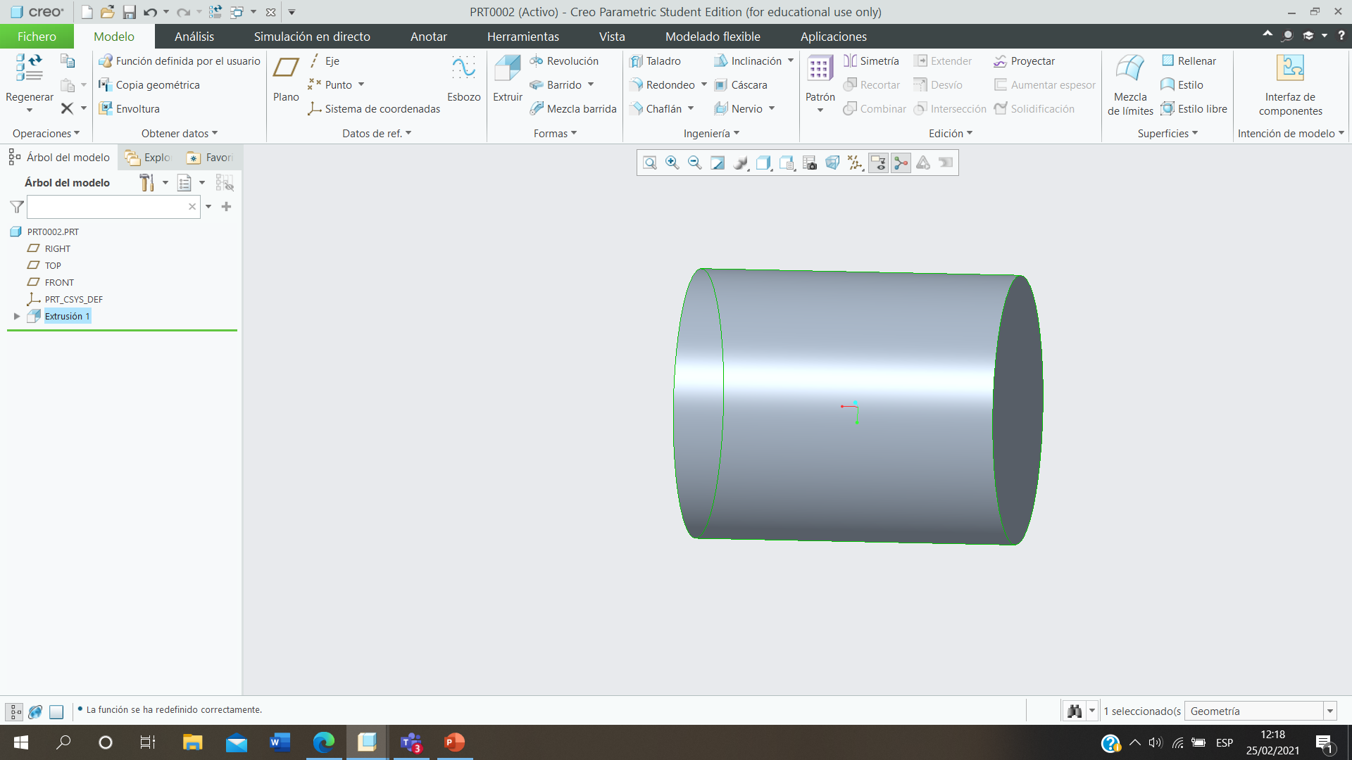
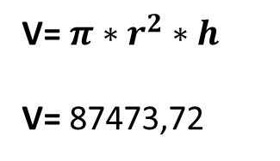
22,5mm
V= $π∗r^{2}∗h$
V= 87473,72
55mm

Slide 13
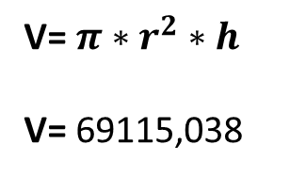
20mm
V= $π∗r^{2}∗h$
V= 69115,038
55mm

Slide 14
Volum | X1 | Y1 | Z1
87473,72mm2 | -27,5-30,25=-57,75mm | 22,5+80=102,5mm | 0
Volum | X2 | Y2 | Z2
69115,038mm2 | -27,5-30,25=-57,75mm | 20+80=100mm | 0
Volum tot aquest troç
18358,682mm2

Slide 15
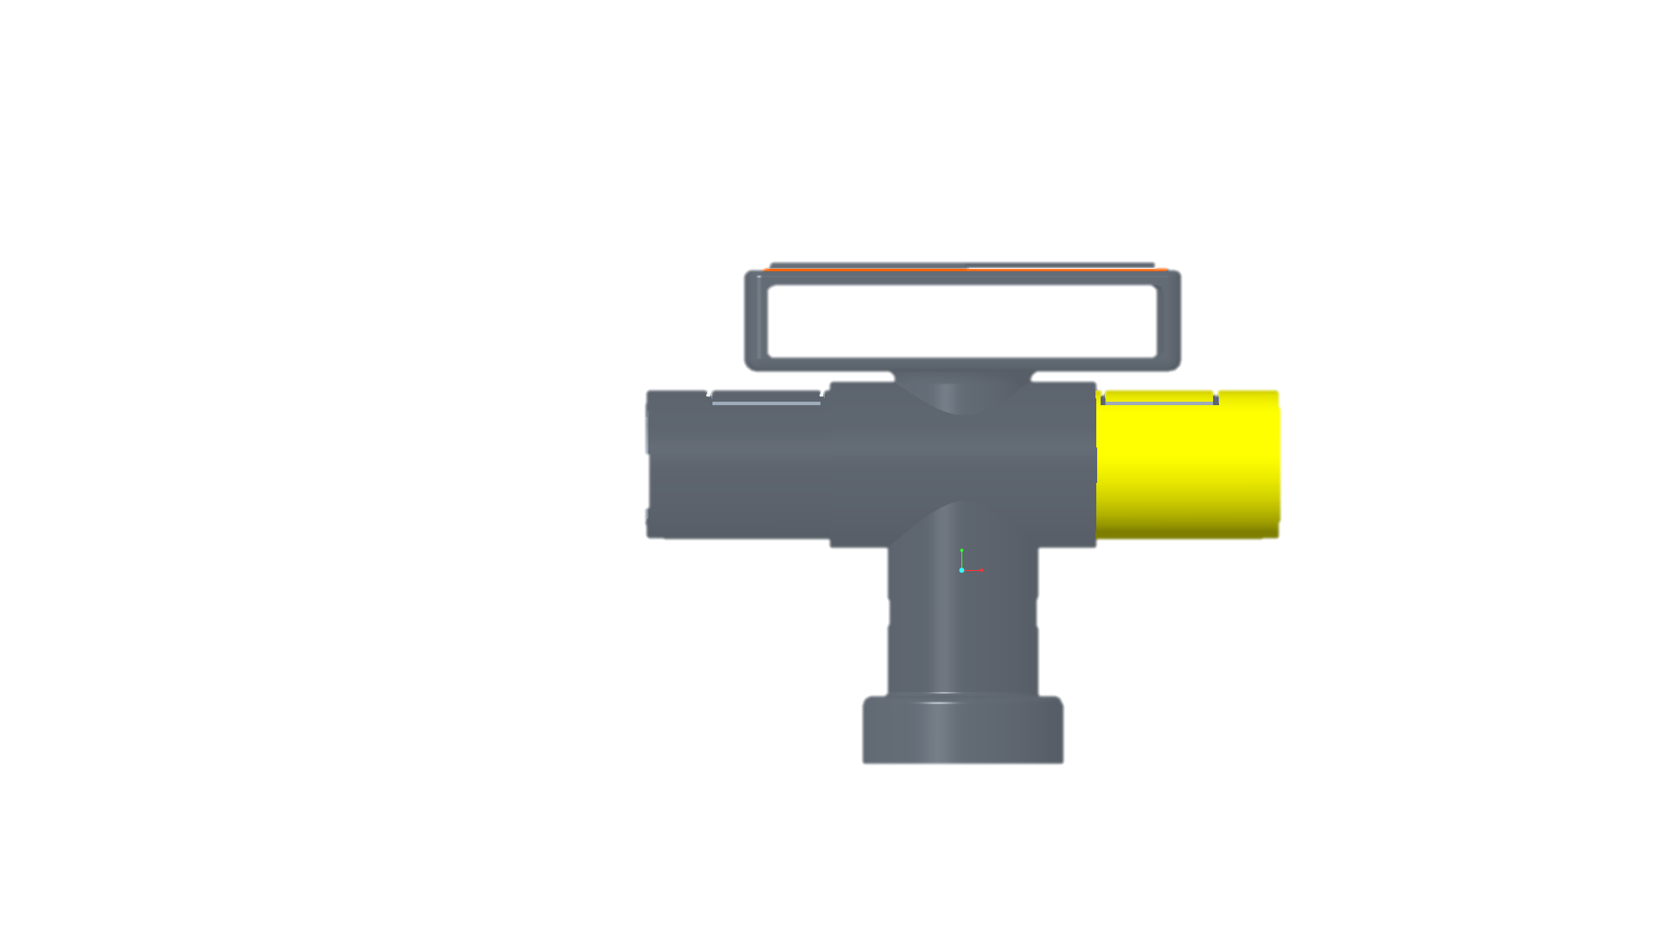
Y
80 - 22,5mm
X
Z

Slide 16
22,5mm
V= $π∗r^{2}∗h$
V= 87473,72
55mm

Slide 17
20mm
V= $π∗r^{2}∗h$
V= 69115,038
55mm

Slide 18
Volum | X1 | Y1 | Z1
87473,72mm2 | 27,5+30,25=+57,75mm | 22,5+80=102,5mm | 0
Volum | X2 | Y2 | Z2
69115,038mm2 | 27,5+30,25=+57,75mm | 20+80=100mm | 0
Volum tot aquest troç
18358,682mm2

Slide 19
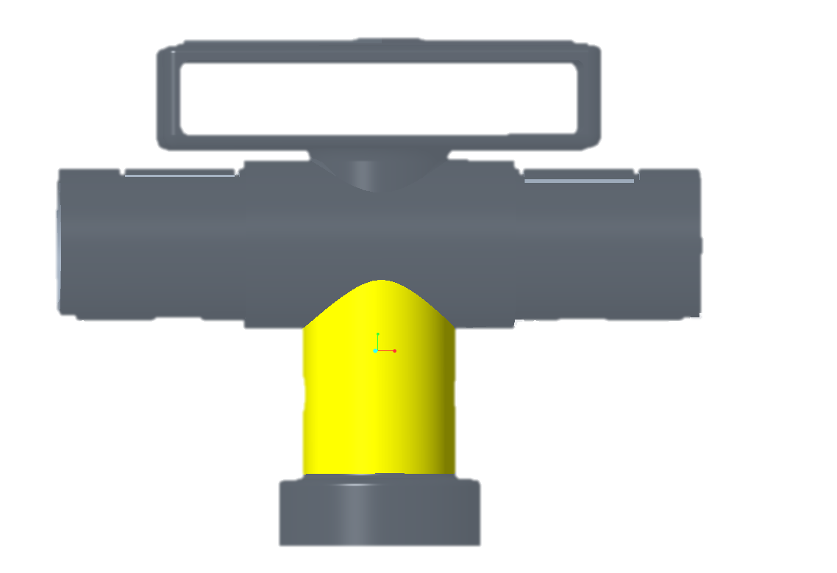
Y
X
Z

Slide 20
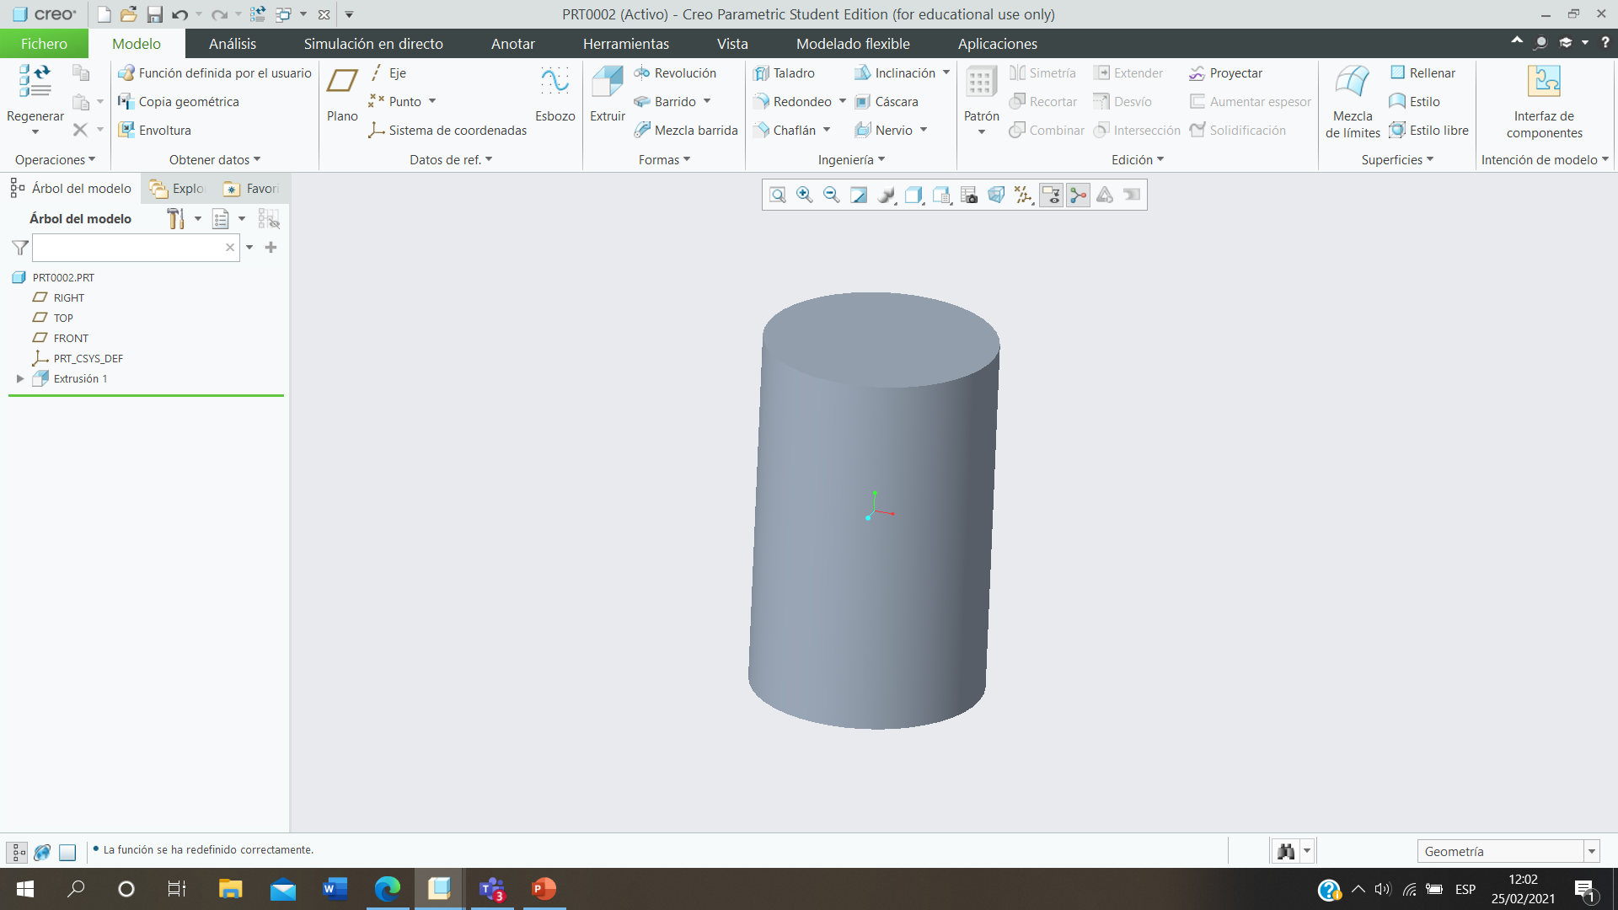
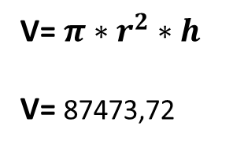
22,5mm
80mm
V= $π∗r^{2}∗h$
V= 87473,72

Slide 21
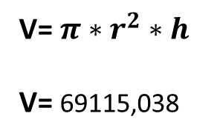
20mm
80mm
V= $π∗r^{2}∗h$
V= 69115,038

Slide 22
Volum | X | Y1 | Z1
100530,965mm2 | 0 | 40mm | 0
Volum | X2 | Y2 | Z2
5654,866mm2 | 0 | 40mm | 0
Volum tot aquest troç
94876,099mm2

Slide 23
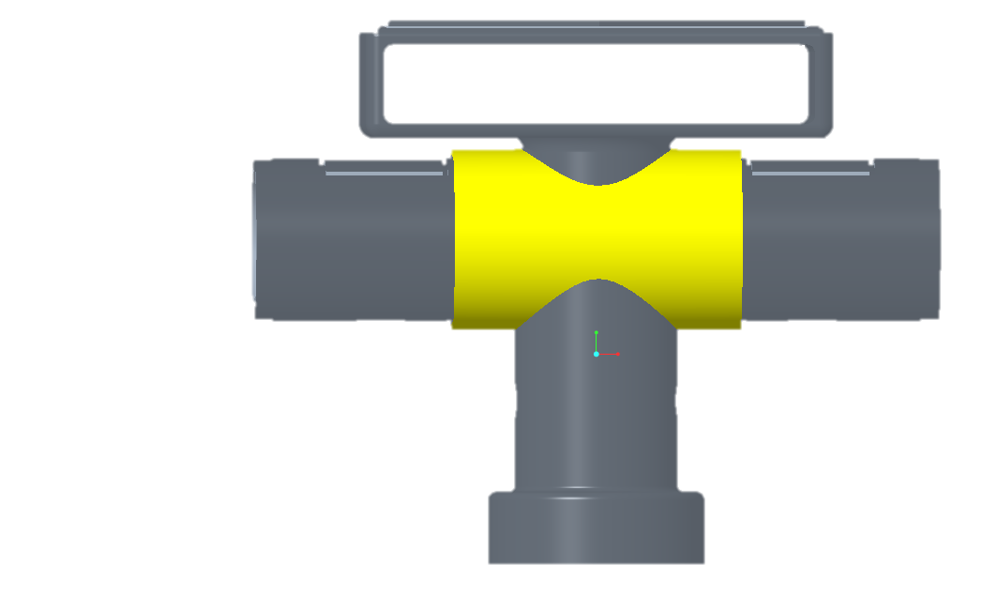
Y
80 - 22,5mm
X
Z

Slide 24
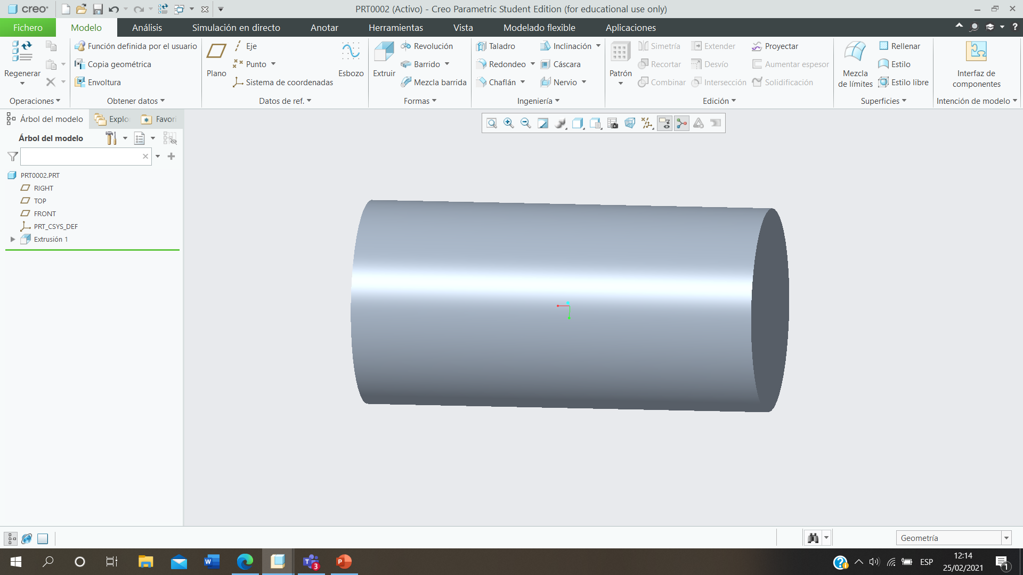
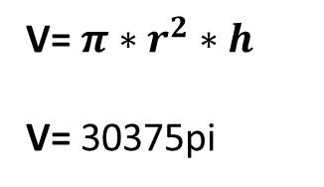
22,5mm
60mm
V= $π∗r^{2}∗h$
V= 30375pi

Slide 25
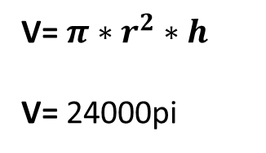
20mm
60mm
V= $π∗r^{2}∗h$
V= 24000pi

Slide 26
Volum | X1 | Y1 | Z1
95425,877mm2 | 0 | 80+22,5=102,5mm | 0
Volum | X2 | Y2 | Z2
75398,224mm2 | 0 | 80+20=100mm | 0
Volum tot aquest troç
20027,653mm2

Slide 27
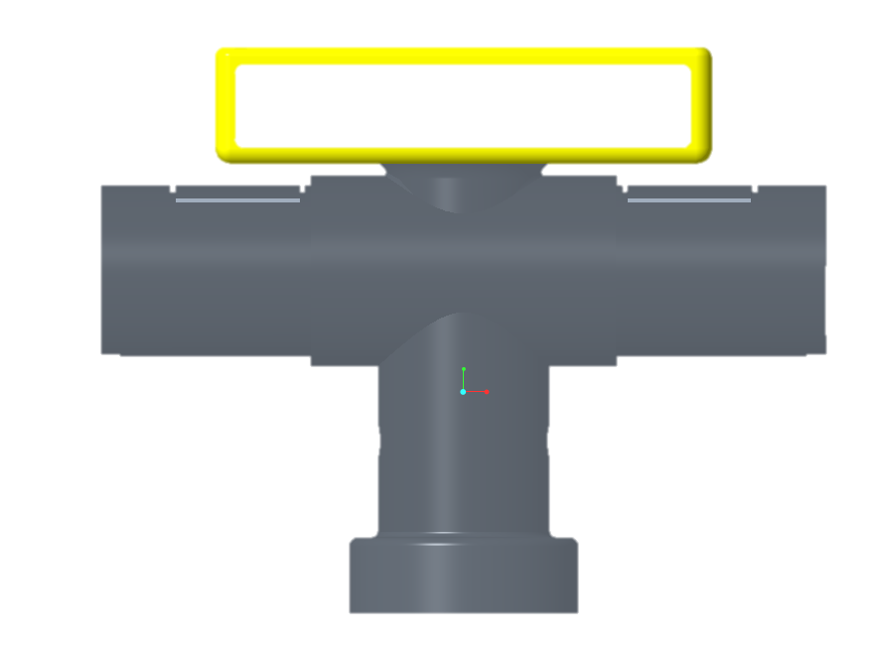
Y
80+10mm
X
Z

Slide 28
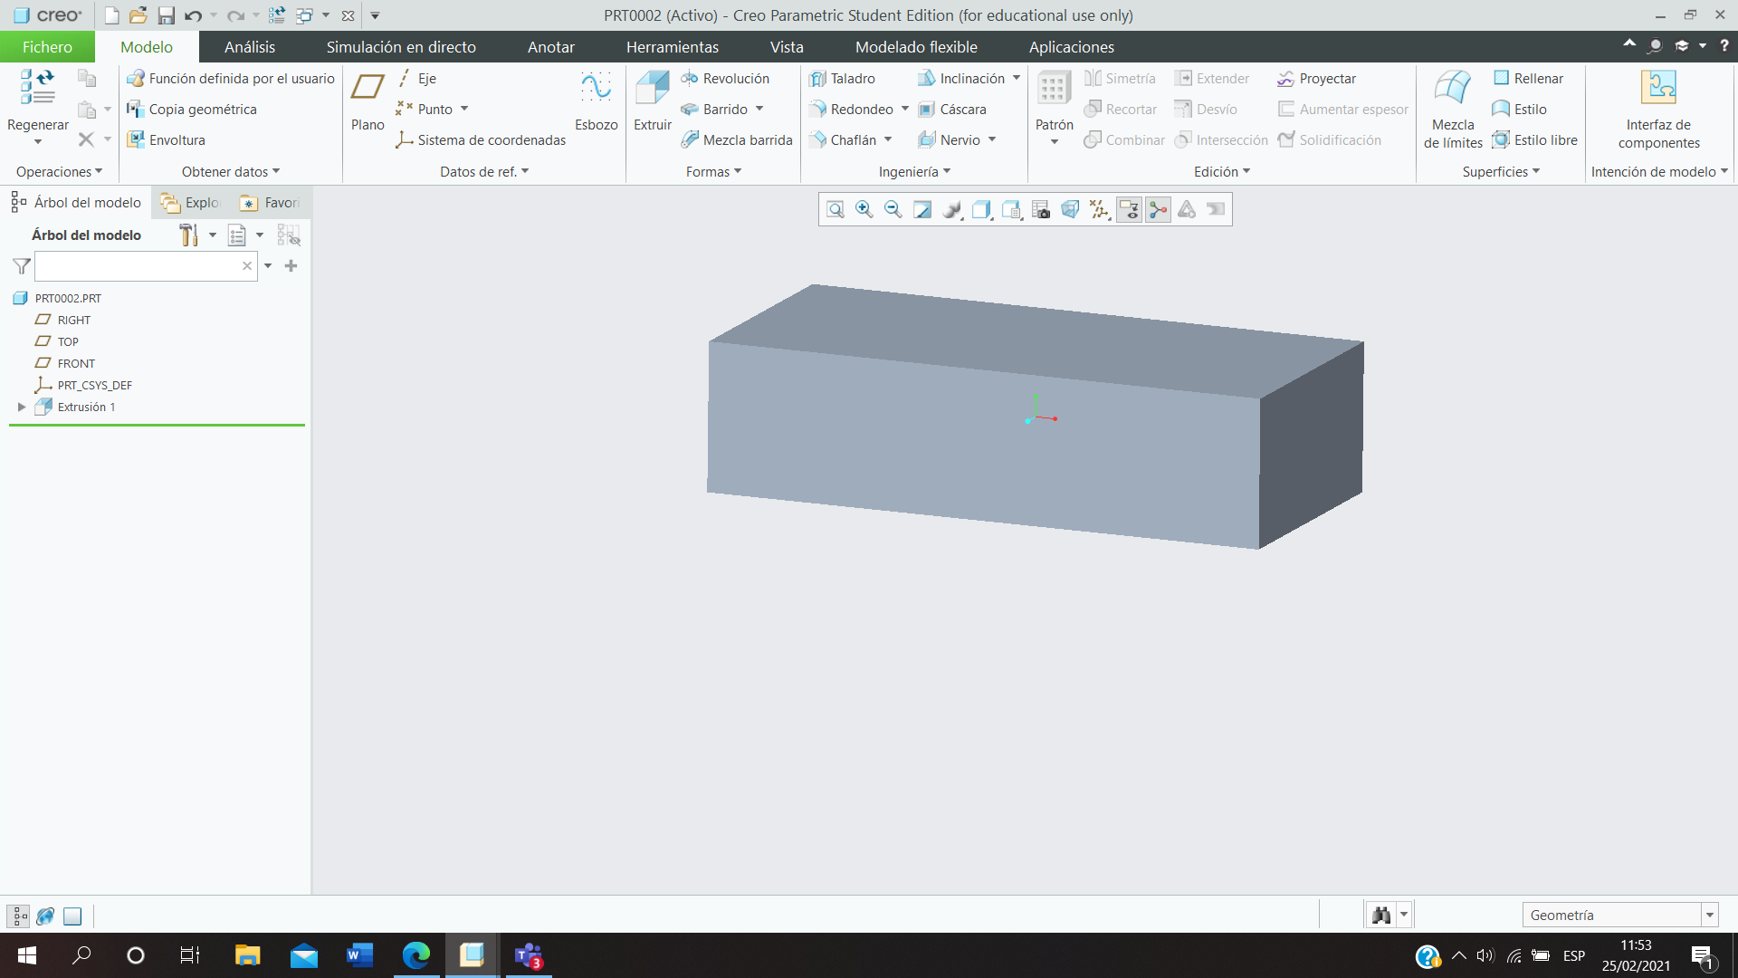
30,5mm
122mm
62mm
V=230702

Slide 29
20mm
119mm
62mm
V= 147560

Slide 30
Volum | X1 | Y1 | Z1
230702mm2 | 0 | 80+15,25+10=105,25mm | 0
Volum | X2 | Y2 | Z2
147560mm2 | 0 | 80+10+5+10=105mm | 0
Volum tot aquest troç
83142mm2

Slide 31
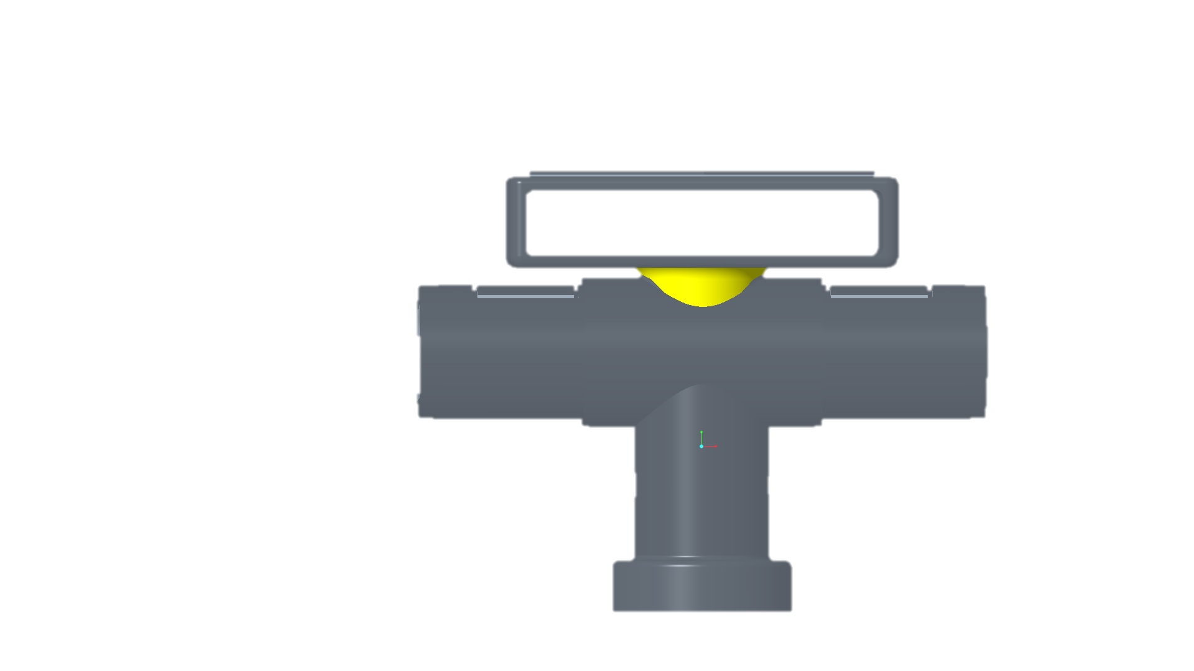
Y
80mm
X
Z

Slide 32
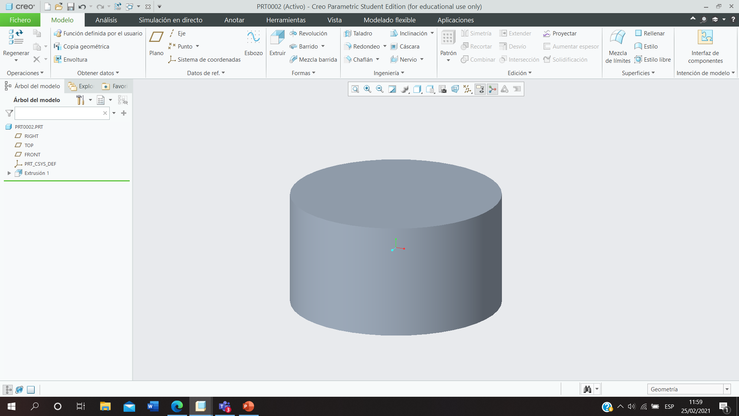
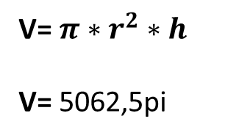
22,5mm
10mm
V= $π∗r^{2}∗h$
V= 5062,5pi

Slide 33
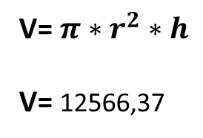
20mm
10mm
V= $π∗r^{2}∗h$
V= 12566,37

Slide 34
Volum | X1 | Y1 | Z1
15904,31mm2 | 0 | 80+5+50=135mm | 0
Volum | X2 | Y2 | Z2
12566,37mm2 | 0 | 80+5+50=135mm | 0
Volum tot aquest troç
3337,94mm2

Slide 35
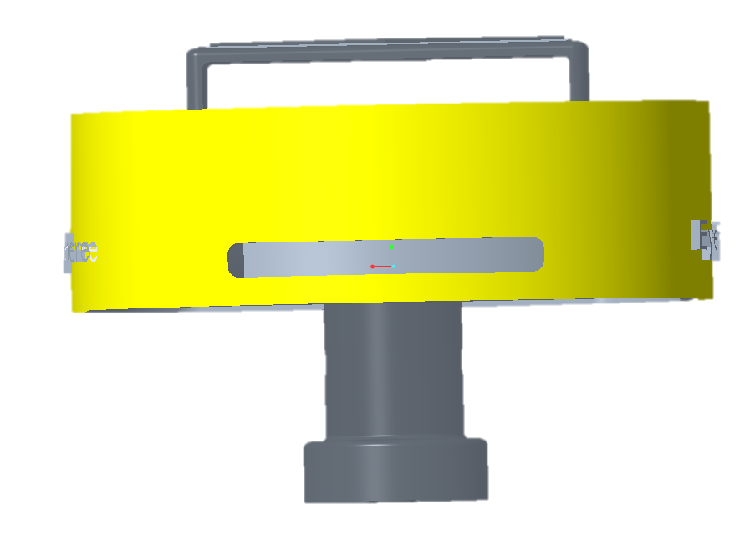
Y
80-30mm
X
Z

Slide 36
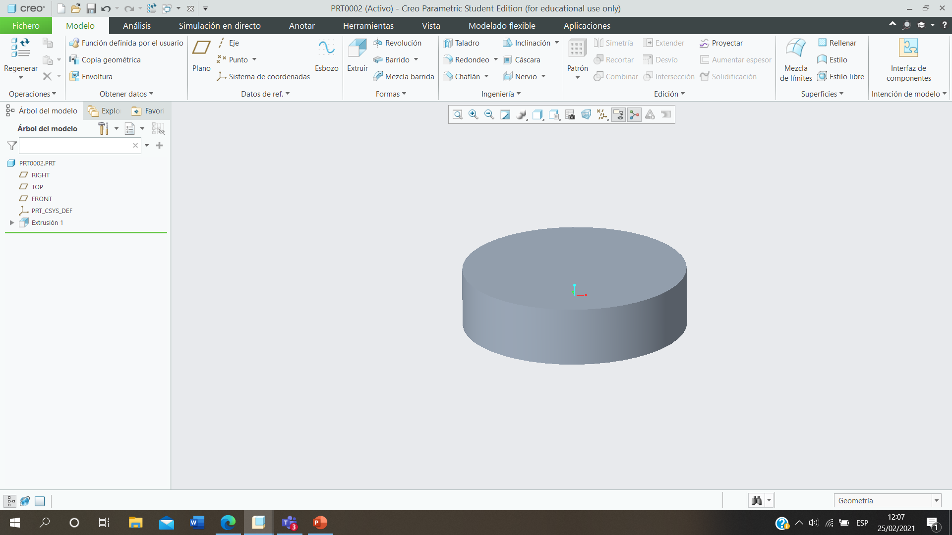
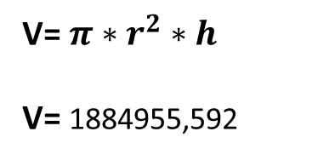
100mm
60mm
V= $π∗r^{2}∗h$
V= 1884955,592

Slide 37
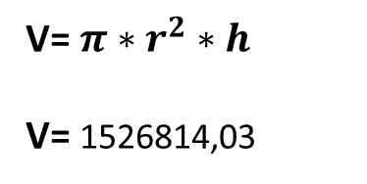
90mm
60mm
V= $π∗r^{2}∗h$
V= 1526814,03

Slide 38
Volum | X1 | Y1 | Z1
1884955,592mm2 | 0 | 80+30=110mm | 0
Volum | X2 | Y2 | Z2
1526814,03mm2 | 0 | 80+30=110mm | 0
Volum tot aquest troç
358141,562mm2

Slide 39
CENTER OF MASSAS TOTAL
Volum | X | Y | Z
87473,72mm2 | -57,75mm | 102,5mm | 0
-69115,038mm2 | 57,75mm | 100mm | 0
100530,965mm2 | 0 | 40mm | 0
-5654,866mm2 | 0 | 40mm | 0
95425,877mm2 | 0 | 102,5mm | 0
-75398,224mm2 | 0 | 100mm | 0
230702mm2 | 0 | 105,25mm | 0
-147560mm2 | 0 | 105mm | 0
15904,31mm2 | 0 | 135mm | 0
-12566,37mm2 |  | 135mm | 0
1884955,592mm2 | 0 | 110mm | 0
-15268140,03mm2 | 0 | 110mm | 0
Volum TOTAL: mm2

Slide 40
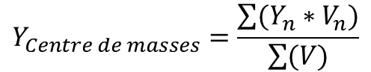
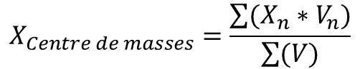
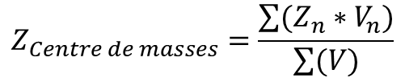
$$X_{Centre de masses}=\frac{\sum{(X_{n}∗V_{n})}}{\sum{(V)}}$$
$$Y_{Centre de masses}=\frac{\sum{(Y_{n}∗V_{n})}}{\sum{(V)}}$$
$$Z_{Centre de masses}=\frac{\sum{(Z_{n}∗V_{n})}}{\sum{(V)}}$$
Volum total | X | Y | Z
596242,618mm2 | 0 | 118,766mm | 0

Slide 41
FOTO PER CALCULS DEL CENTRE DE INERCIES, respecte el serbomotor

Slide 42
Y
Y’
Io1=
X’
X
Z
Z’
22,5mm

Slide 43
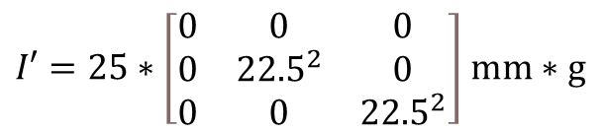
$I_{x}=\frac{1}{2}∗m∗r^{2}=\frac{1}{2}∗25∗{45}^{2}=25312.5$ $mm∗g$
$$I_{y}=I_{z}=\frac{1}{12}∗m∗\left(3∗r^{2}+l^{2}\right)=\frac{1}{12}∗25∗\left(3∗{45}^{2}+{55}^{2}\right)=12770.83 mm∗g$$
$I′=25∗\left[\begin{matrix}0 & 0 & 0 \\ 0 & {22.5}^{2} & 0 \\ 0 & 0 & {22.5}^{2}\end{matrix}\right]$ $mm∗g$
${\left|I_{0}\right|}_{1}=I^{′}+I_{xyz}=\left[\begin{matrix}0 & 0 & 0 \\ 0 & 12656.25 & 0 \\ 0 & 0 & 12656.25\end{matrix}\right]+\left[\begin{matrix}25312.5 & 0 & 0 \\ 0 & 12770.83 & 0 \\ 0 & 0 & 12770.83\end{matrix}\right]=\left[\begin{matrix}25312.5 & 0 & 0 \\ 0 & 25427.08 & 0 \\ 0 & 0 & 25427.08\end{matrix}\right]$ $mm∗g$

Slide 44
Io2=
Y’
Y
Z’
Z
X’
X
30mm

Slide 45
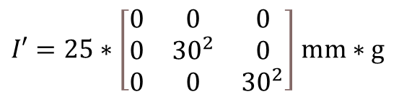
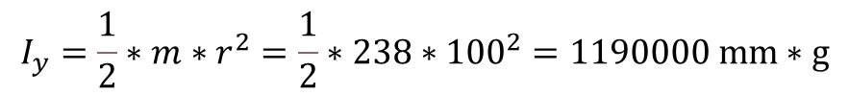
$$I_{y}=\frac{1}{2}∗m∗r^{2}=\frac{1}{2}∗238∗{100}^{2}=1190000 mm∗g$$
$$I_{x}=I_{z}=\frac{1}{12}∗m∗\left(3∗r^{2}+l^{2}\right)=\frac{1}{12}∗238∗\left(3∗{100}^{2}+{60}^{2}\right)=666400 mm∗g$$
$I′=25∗\left[\begin{matrix}0 & 0 & 0 \\ 0 & {30}^{2} & 0 \\ 0 & 0 & {30}^{2}\end{matrix}\right]$ $mm∗g$
${\left|I_{0}\right|}_{2}=I^{′}+I_{xyz}=\left[\begin{matrix}0 & 0 & 0 \\ 0 & 214200 & 0 \\ 0 & 0 & 214200\end{matrix}\right]+\left[\begin{matrix}1190000 & 0 & 0 \\ 0 & 666400 & 0 \\ 0 & 0 & 666400\end{matrix}\right]=\left[\begin{matrix}1190000 & 0 & 0 \\ 0 & 880600 & 0 \\ 0 & 0 & 880600\end{matrix}\right]$mm*g

Slide 46
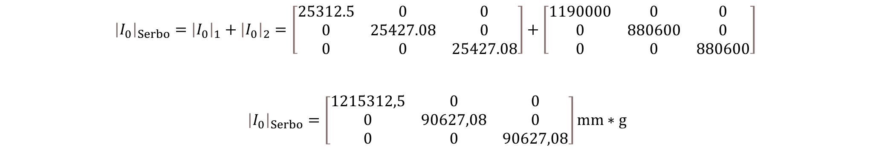
INERCIA TOTAL
SERBO
$${\left|I_{0}\right|}_{Serbo}={\left|I_{0}\right|}_{1}+{\left|I_{0}\right|}_{2}=\left[\begin{matrix}25312.5 & 0 & 0 \\ 0 & 25427.08 & 0 \\ 0 & 0 & 25427.08\end{matrix}\right]+\left[\begin{matrix}1190000 & 0 & 0 \\ 0 & 880600 & 0 \\ 0 & 0 & 880600\end{matrix}\right]$$
${\left|I_{0}\right|}_{Serbo}=\left[\begin{matrix}1215312,5 & 0 & 0 \\ 0 & 90627,08 & 0 \\ 0 & 0 & 90627,08\end{matrix}\right]mm∗g$

Slide 47
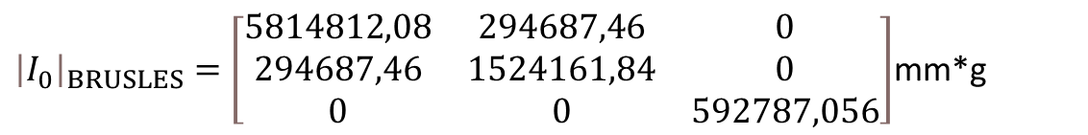
INERCIA TOTAL
BRUSLES
${\left|I_{0}\right|}_{BRUSLES}=$ $\left[\begin{matrix}5814812,08 & 294687,46 & 0 \\ 294687,46 & 1524161,84 & 0 \\ 0 & 0 & 592787,056\end{matrix}\right]$mm*g

Slide 48
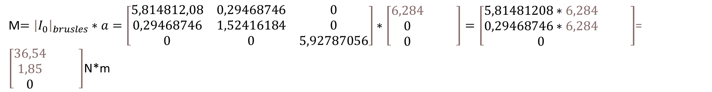
Calculation parell motor/torque BRUSLES
${\left|I_{0}\right|}_{BRUSLES}=$ $\left[\begin{matrix}5814812,08 & 294687,46 & 0 \\ 294687,46 & 1524161,84 & 0 \\ 0 & 0 & 592787,056\end{matrix}\right]$mm*g
$α=θ$/t = $\frac{\text{3,142} rad/s}{0,5s}$ = $\left[\begin{matrix}6,284 & & \\ 0 & & \\ 0 & & \end{matrix}\right]{rad/s}^{2}$
M$={\left|I_{0}\right|}_{brusles}∗a=\left[\begin{matrix}5,814812,08 & 0,29468746 & 0 \\ 0,29468746 & 1,52416184 & 0 \\ 0 & 0 & 5,92787056\end{matrix}\right]∗\left[\begin{matrix}6,284 & & \\ 0 & & \\ 0 & & \end{matrix}\right]=\left[\begin{matrix}5,81481208∗6,284 & & \\ 0,29468746∗6,284 & & \\ 0 & & \end{matrix}\right]$= $\left[\begin{matrix}36,54 & & \\ 1,85 & & \\ 0 & & \end{matrix}\right]$N*m

Slide 49
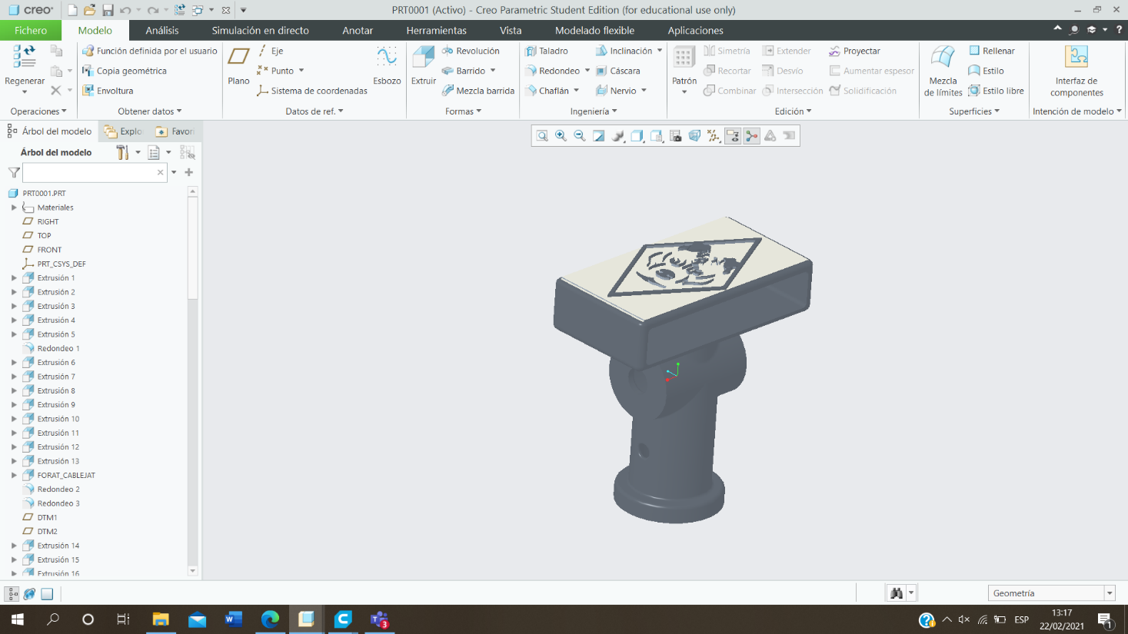
x1

Slide 50
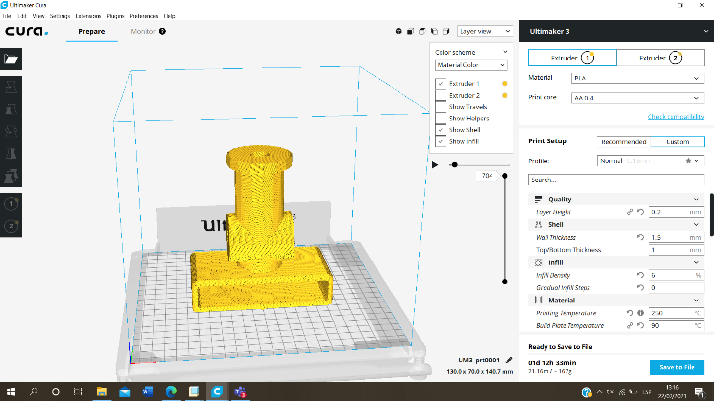

Slide 51


Slide 52


Slide 53
PES Total : 217g +soporte camaras+1motor+ 2camaras= 30 g +1blasberry py=45g
+1arduino= 22.7g+serbo= 66 g +1placa adaptador+motor= 73 g = 486.7g +soporte camaras=238g=724.7g

Slide 54
𝐂𝐡𝐫𝐢𝐬𝐭𝐦𝐚𝐬 𝐂𝐚𝐫𝐧𝐢𝒗𝐚𝐥 Nema 23 Motor paso a paso de 2 fases con controlador 1NM Motor paso a paso de control industrial de 24 ° 24V/3A: Amazon.es: Industria, empresas y ciencia
Motor paso a paso, FY56EC350A Nema23 Motor paso a paso 2 fases 2.2NM 3.5A, ángulo de paso 1.8 °, para control de motores industriales, ocasiones de transmisión: Amazon.es: Industria, empresas y ciencia

